Slide 1
Text Analysis in Python
Sentiment analysis

Slide 2
Overview
 | Content | Duration
1 | Introduction to text analysis Download lesson materials What is sentiment analysis | 30 min
2 | Demonstration & hands on Data cleaning Exploratory data analysis Sentiment analysis | 50 min
3 | Conclusion Summary Additional resources | 10 min

Slide 3

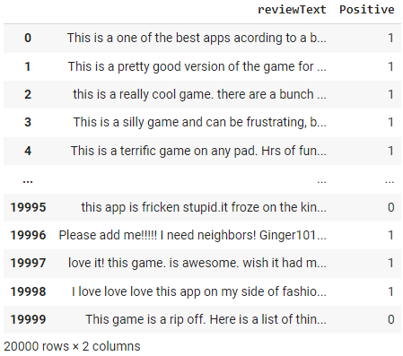

Why text analysis in Python?
“love it! This game is awesome…”
“This is a really cool game…”
“This is a silly game and can be frustrating…”
“This game is a rip off…”

Slide 4
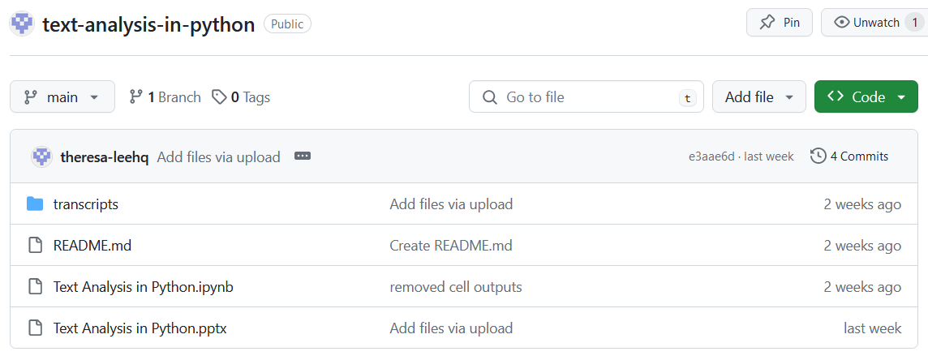
Download lesson materials
Go to https://github.com/theresa-leehq/text-analysis-in-python and follow the instructions.

Slide 5
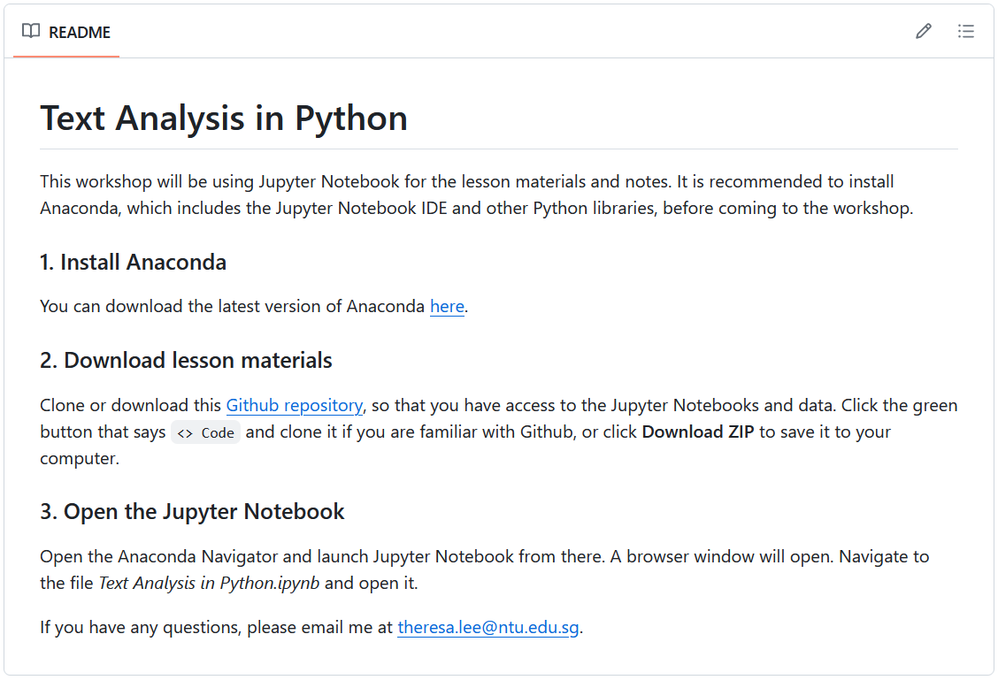

Slide 6
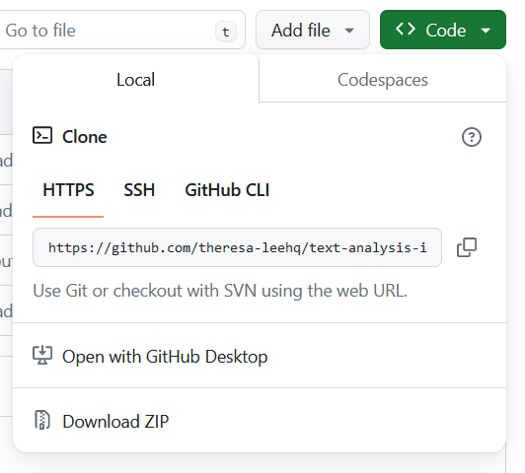
1. Click the green ‘Code’ button
2. Click the ‘Download ZIP’ button

Slide 7
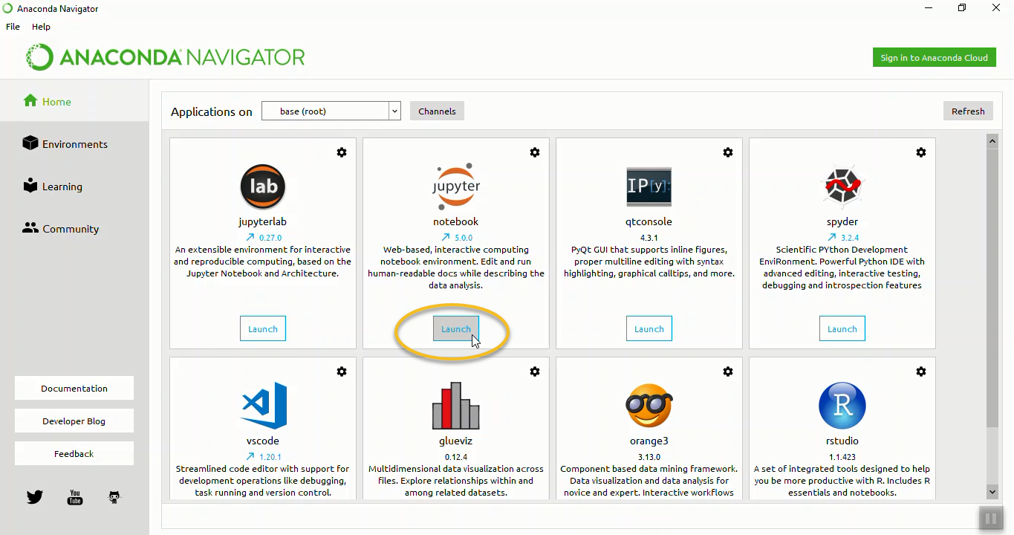
Launch Jupyter notebook
1. Open Anaconda Navigator
2. Click ‘Launch’ under Jupyter notebook

Slide 8
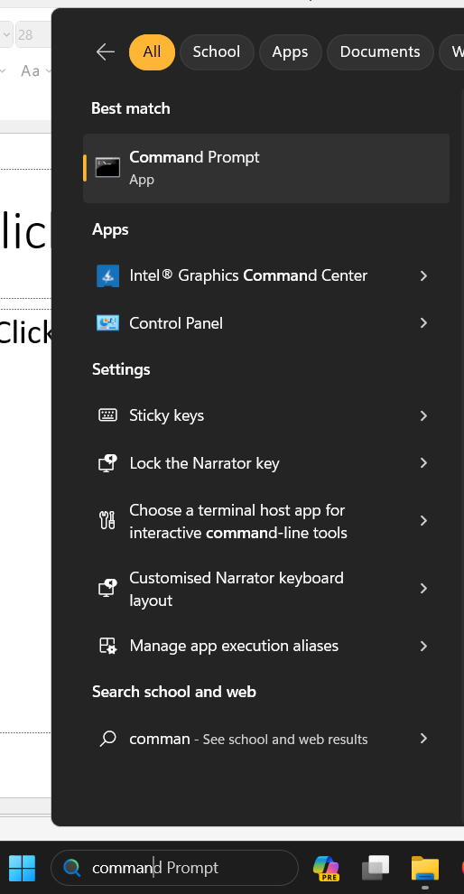
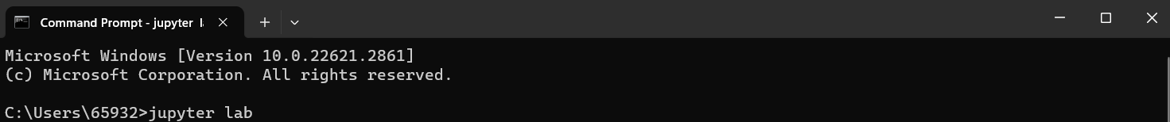
Launch Jupyter Lab
Type ‘Command Prompt into Windows search bar
Type ‘jupyter lab’ on the command line
'jupyter' is not recognized as an internal or external command,
operable program or batch file.

Slide 9
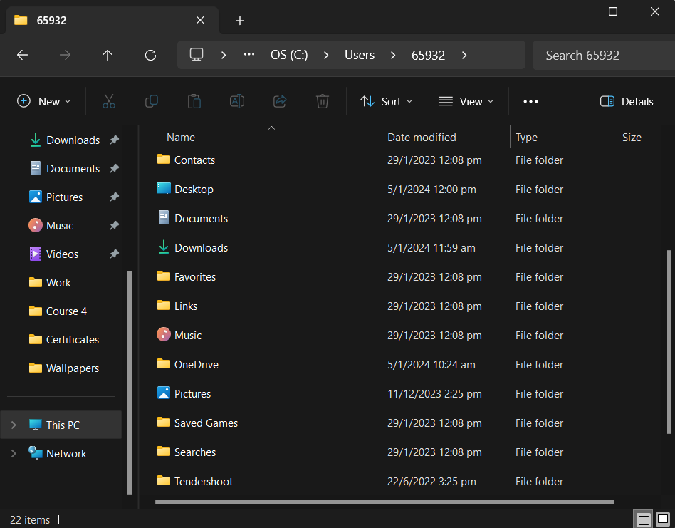
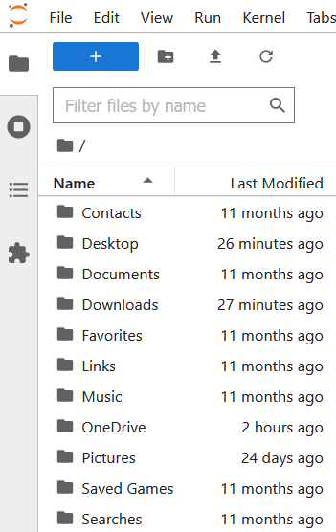
Open workshop notebook
It’s the same!

Slide 10
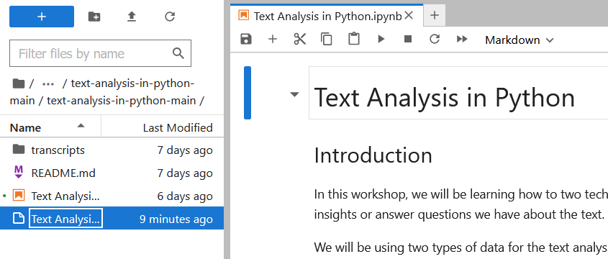

Slide 11
Workflow – repeat slide
Get and clean data
Perform exploratory data analysis
Apply techniques
Positive/negative
Train classifier
Share insights

Slide 12
Workflow – repeat slide
Get and clean data
Perform exploratory data analysis
Apply techniques
Positive/negative
Train classifier
Share insights

Slide 13
Sentiment Analysis
Data – 2000 movie reviews sorted into positive and negative categories
NLTK (Natural Language Toolkit)
Python package for NLP (Natural Language Processing)

Slide 14
Sentiment Analysis
Install NLTK and download data
Clean the data
Standardise text and remove irrelevant characters (punctuation, numbers)
Remove stop words (e.g. the, a, it, is)
Lowercase letters
Exploratory data analysis
Find word frequency
Perform sentiment analysis

Slide 15
Sentiment Analysis
Input: Corpus – a collection of texts
Review ID | Text
'pos/cv000_29590.txt' | films adapted from comic books have had plenty of success , whether they\'re about superheroes ( batman , superman , spawn ) …
'pos/cv001_18431.txt' | every now and then a movie comes along from a suspect studio , with every indication that it will be a stinker , and to everybody\'s surprise ( perhaps even the studio ) …
'pos/cv002_15918.txt' | you've got mail works alot better than it deserves to . \nin order to make the film a success , all they had to do was cast two extremely popular and attractive stars …
… | …

Slide 16
Data Cleaning
every now and then a movie comes along from a suspect studio , with every indication that it will be a stinker , and to everybody\'s surprise ( perhaps even the studio ) the film becomes a critical darling .
every now and then a movie comes along from a suspect studio with every indication that it will be a stinker and to everybody s surprise perhaps even the studio the film becomes a critical darling
Remove punctuation
Remove numbers
Lowercase letters

Slide 17
Data Cleaning
Tokenization – split text into smaller pieces (i.e. tokens). Most commonly tokens are words or sentences.
every now and then a movie comes along from a suspect studio with every indication that it will be a stinker and to everybody s surprise perhaps even the studio the film becomes a critical darling
every movie comes along suspect studio every indication stinker everybody surprise perhaps even studio film becomes critical darling
Remove stop words

Slide 18
Demo

Slide 19
Workflow – repeat slide
Get and clean data
Perform exploratory data analysis
Apply techniques
Positive/negative
Train classifier
Share insights

Slide 20
Exploratory data analysis
Frequency distribution
film | one | movie | like | even | good | time | story | would | much
9517 | 5852 | 5771 | 3962 | 2565 | 2411 | 2411 | 2169 | 2109 | 2049

Slide 21
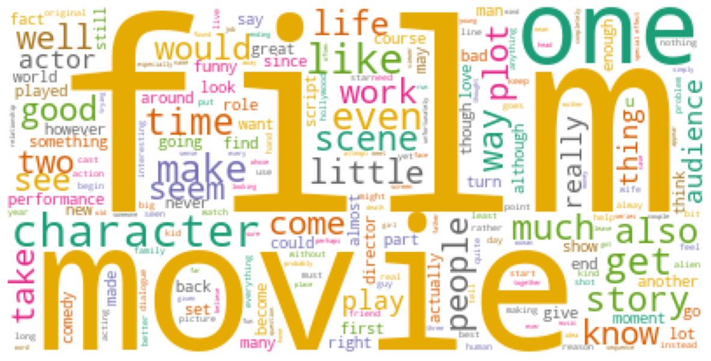
Create word cloud

Slide 22
Demo

Slide 23
Workflow – repeat slide
Get and clean data
Perform exploratory data analysis
Apply techniques
Positive/negative
Train classifier
Share insights

Slide 24
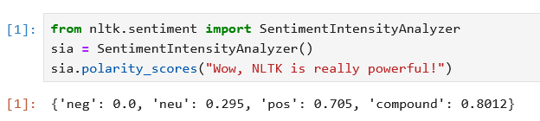

Sentiment Analysis
VADER (Valence Aware Dictionary and sEntiment Reasoner)
-1 is negative, +1 is positive, 0 is neutral

Slide 25
Demo

Slide 26
Identify positive reviews
Features of positive reviews:
Positive words – most frequent words found in positive reviews (frequency distribution)
Positive sentiment score (sentiment analyser)
Movie review
- Number of positive words
- Sentiment score of review
Positive or negative
Extract features
Sort review

Slide 27
Demo

Slide 28
Workflow – repeat slide
Get and clean data
Perform exploratory data analysis
Apply techniques
Positive/negative
Train classifier
Share insights

Slide 29
Classify new data
Find a new movie review
Pass data through trained classifier

Slide 30
Demo

Slide 31
Summary
Text pre-processing
Exploratory data analysis
Sentiment analysis

